Slide 1
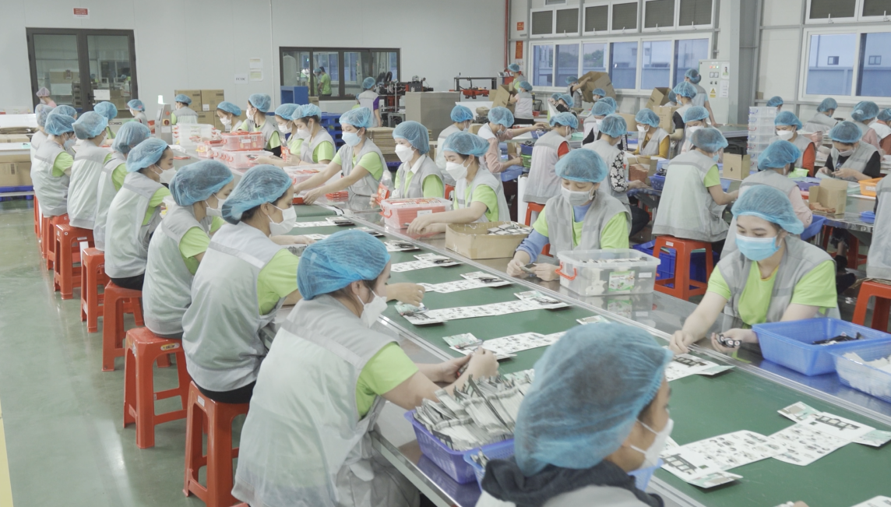
Welcome to:
HH DREAM PRINTING
We make ideas tangible, solutions sustainable, and products that benefit society..
By building on our heritage of strong partnership and business innovation, we create sustainable printed products and solutions that enhance every life.
Notes:
Welcome to HHD,

Slide 2
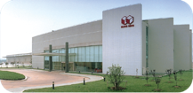
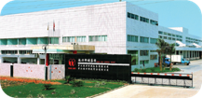
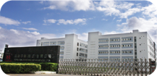
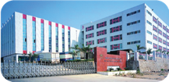
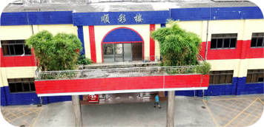
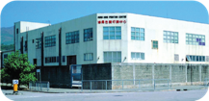
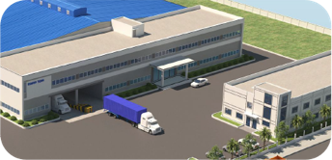
Production plants of Hung Hing
Hong Kong
Shenzhen
Zhongshan
Wuxi
Heshan
Shunde
Vietnam
Relocated to Tai Po
Industrial Estate in
1989.
Corporate headquarters
2 production lines for
conventional books.
300 full time staff/ workers.
Printing and
manufacturing of folding
cartons, children’s book,
conventional books,
litholam and corrugated
containers.
Awarded ISO9001;
ISO14001 and ICTI-COBP certifications.
2800-5000 full time
workers of which 1400-3400 hand assembled related.
Printing and
manufacturing of
folding cartons,
litholam and
corrugated containers.
Awarded ISO9001;
ISO 14001 &
BRC/IOP certifications
890 full time workers.
Printing and
manufacturing of
folding cartons,
litholam and corrugated
containers.
Awarded ISO9001;
ISO 14001 & BRC/IOP
certifications.
500-800 full time
workers of which
200-450 hand
assembly related.
Established in 2007
for printing children’s
and conventional
books.
Awarded ISO9001;
ISO 14001;
ICTI-COBP &
BRC/IOP certificatios;
M&S Eco-factory.
2200-3000 full time workers of which
1400- 2000 hand
assembly related.
Printing and
manufacturing of
folding cartons,
litholam, corrugated
containers and
corrugated board.
A strong market
position in the
production of
corrugated and cases
Mult-location network strategy to achieve
growth.
Established in 2019
Printing and manufacturing of stationary and packaging.
Land area 35,000sq. Meter
(Factory + office 15,200sq.
Meter)
Mainly producing color packaging & paper toy
Established
Established
2003
1994
2007
Wuxi
Zhongshan
Heshan
Established
Acquired
1994
2018
Shenzhen
Shunde
Established
Established
1950
2019
Hong Kong
Vietnam
Notes:
Established in 2019 for Printing and manufacturing of packaging, litho lam and corrugated containers.

Slide 3
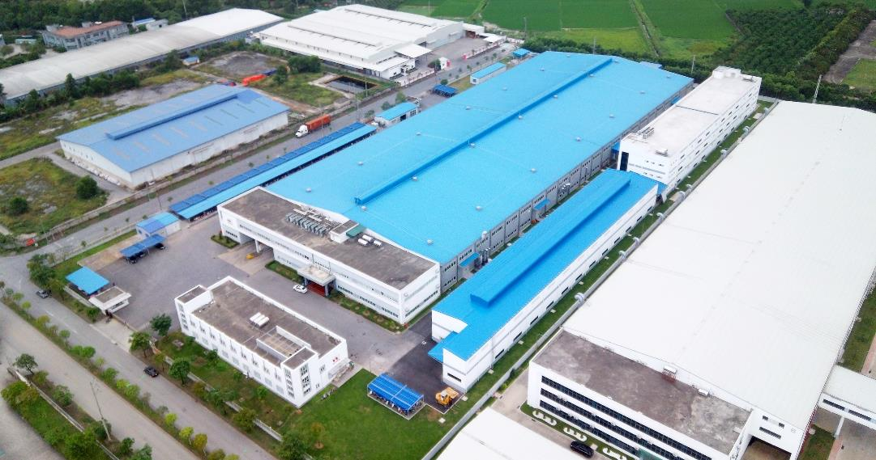
PANORAMA

Slide 4
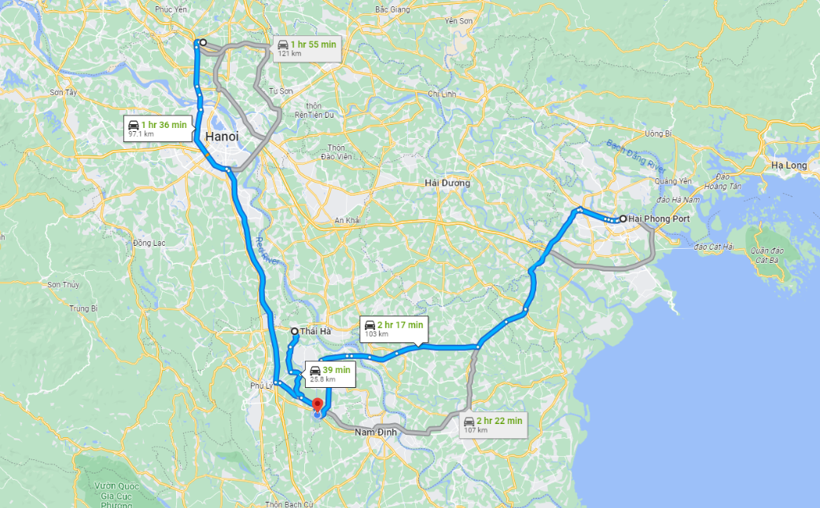
LOCATION

Slide 5
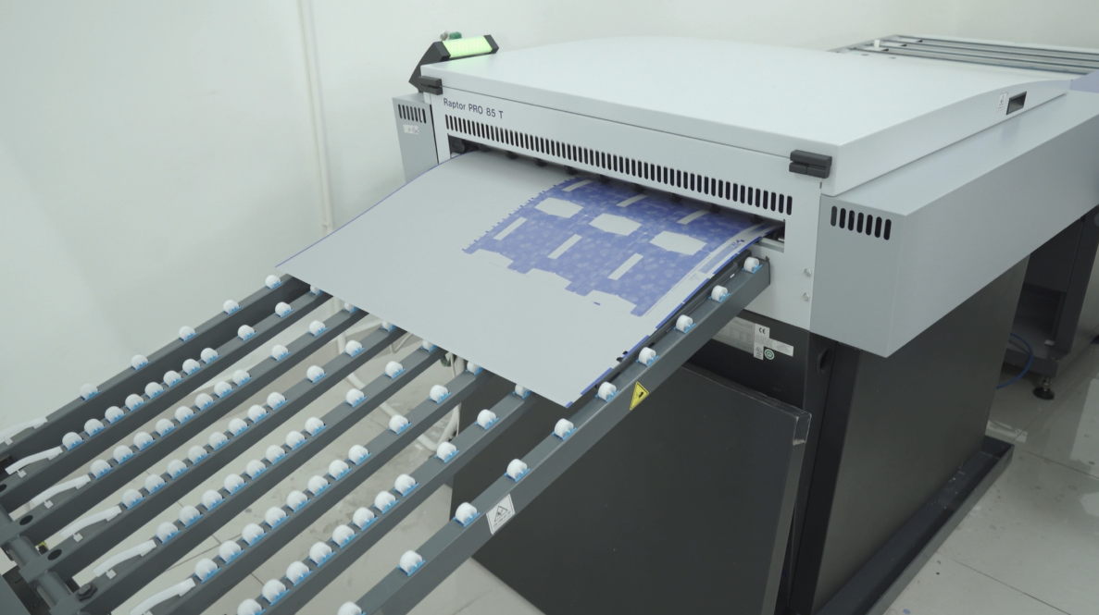
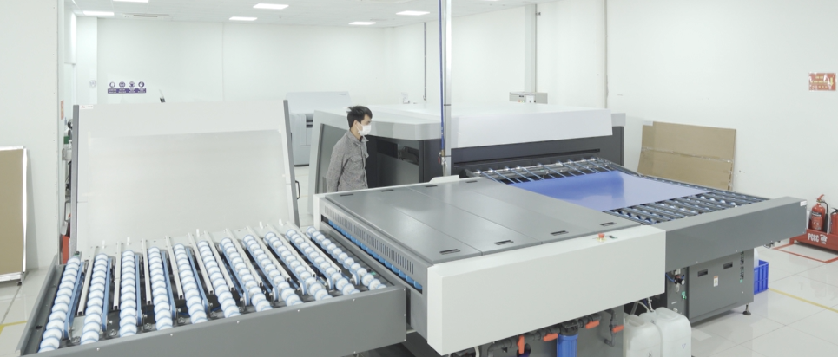
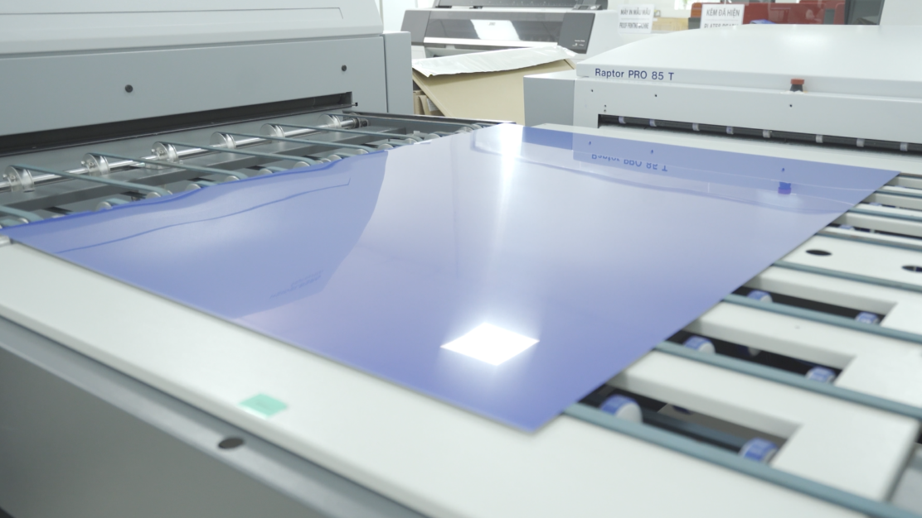
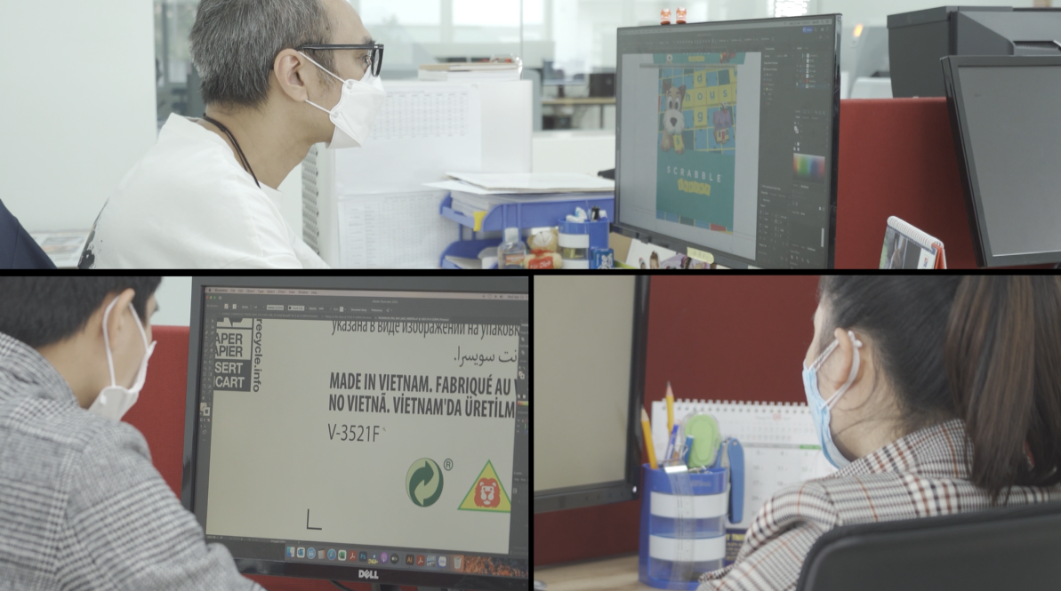
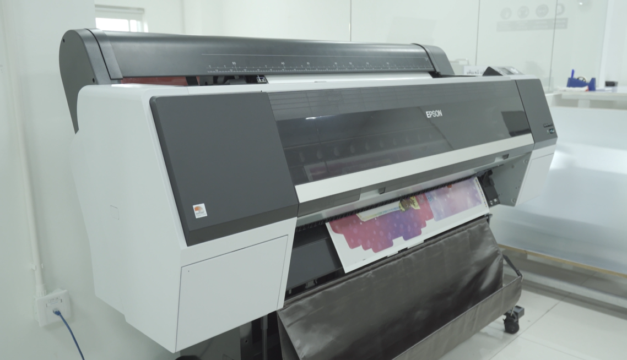
CTP SYSTEM
Machine Type | QTY | Brand | MODEL NO. | max size mm | min size mm | capacity(pcs/h) | Averege Output/ hr. | Origin
CTP System | 1 | Heidelberg | Suprasetter 106 | 930x1140 | 323x370 | 29 Sheets | 12 Sheets | Germany
CTP System | 1 | Heidelberg | Suprasetter 145 | 1425x1460 | 500x650 | 25 Sheets | 1S Sheets | Germany
Machine Type | QTY | Brand | MODEL NO. | max size mm | min size mm | capacity(pcs/h) | Averege Output/ hr. | Origin
Digital Proofer | 1 | Epson | P9000 True Color | NA | NA | NA | NA | US
Plotter/Sample Maker | 1 | Aoke | DCZ701713 | 1700x1300 | NA | NA | NA | China

Slide 6
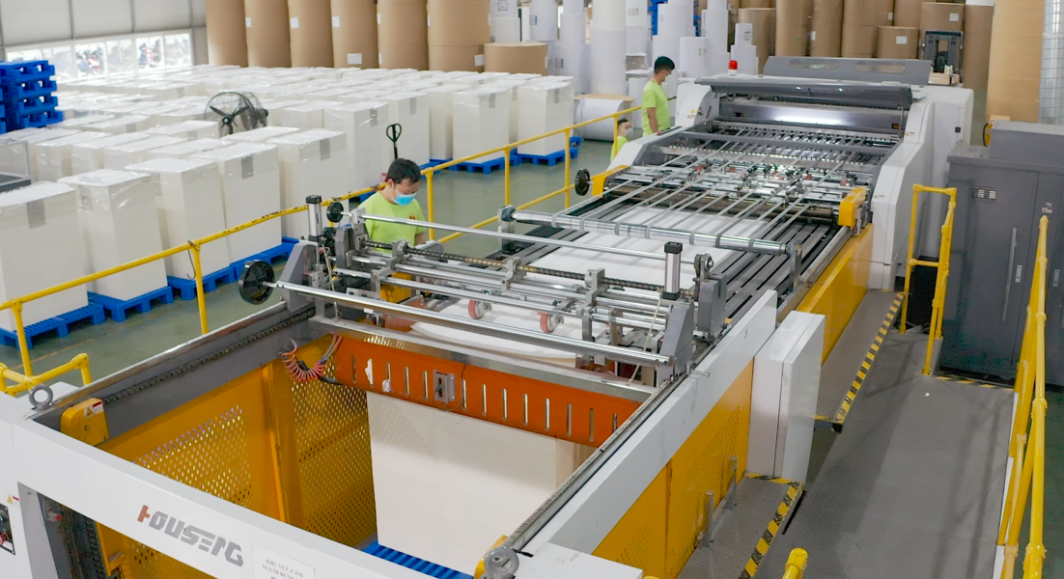
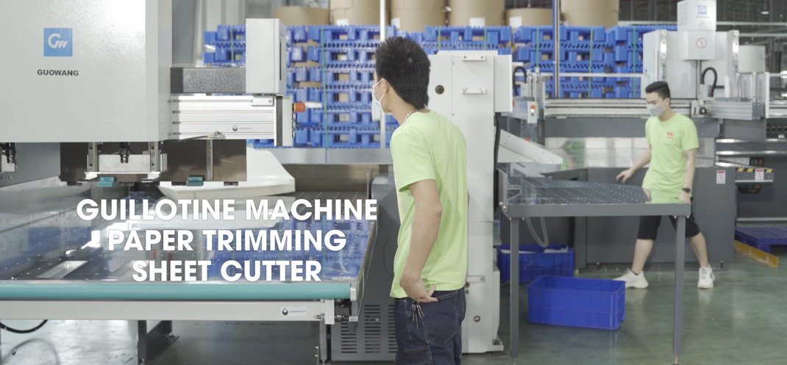
SHEET CUTTER
HOUSENG HSC1500S
Machine Type | QTY | Brand | MODEL NO.
Rotary Sheet Cutter | 1 | Houseng | HSC1500S
max size mm | min size mm | capacity(pcs/h)
1500x1650 | 1500x400 | 7800-22500s/h
HOUSENG HSC1700S
Machine Type | QTY | Brand | MODEL NO.
Rotary Sheet Cutter | 1 | Houseng | HSC1700S
max size mm | min size mm | capacity(pcs/h)
1600x1700 | 1500x400 | 7800-22500s/h
GUOWANG QS4 / Di76G / G54
Machine Type | QTY | Brand
Automation Cutting System | 1 | Guowang
MODEL NO. | Max width
QS4 / Di76G / G54 | 1760mm
Machine Type | QTY | Brand | MODEL NO.
Guillotine | 1 | Guowang | K-115SE
max size mm | min size mm | capacity(pcs/h)
w:1150mm | NA | NA

Slide 7
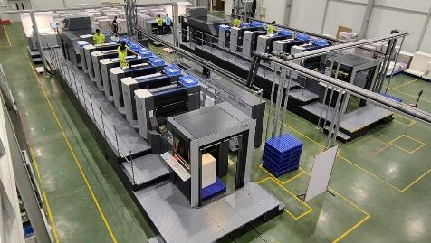
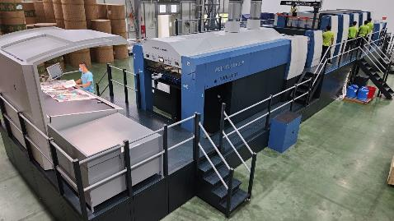
PRINTING
HEIDELBERG CD102-6+L
Machine Type | QTY | Brand | MODEL NO.
Offset Printing | 1 | Heidelberg | CD102-6+L
max size mm | min size mm | capacity(pcs/h)
720x1020 | 340x480 | 15000
HEIDELBERG CD102-5+L
Machine Type | QTY | Brand | MODEL NO.
Offset Printing | 1 | Heidelberg | CD102-5+L
max size mm | min size mm | capacity(pcs/h)
720x1020 | 340x480 | 15000
KBA RAPIDA 145-5+L
Full Size Printing Machine
Machine Type | QTY | Brand | MODEL NO.
Offset Printing | 1 | KBA | Rapida 145-5+L
max size mm | min size mm | capacity(pcs/h)
1450x1060 | 600x500 | 13000

Slide 8
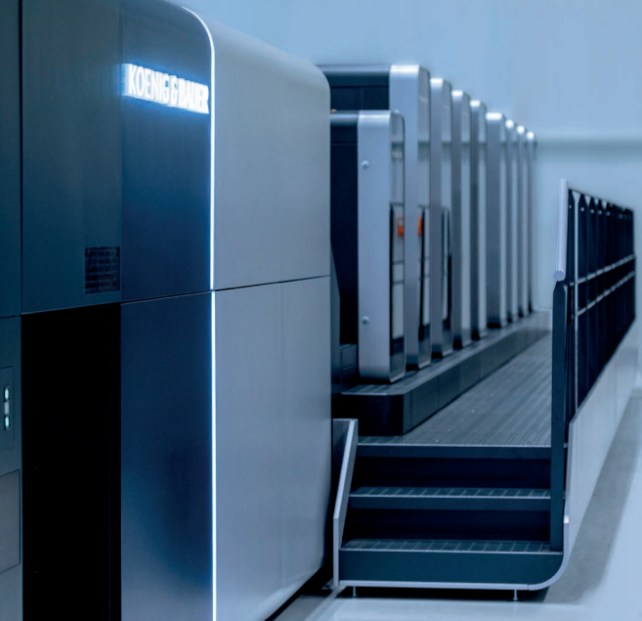
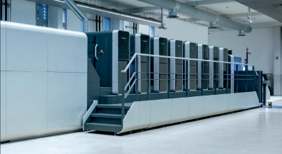
PRINTING
Rapida106
Arrived in fist half of 2023
Under production.
Machine Type | QTY | Brand | MODEL NO.
Offset Printing | 1 | KBA | Rapida106
max size mm | min size mm | capacity(pcs/h)
1060x740 | 340x480 | 18000

Slide 9
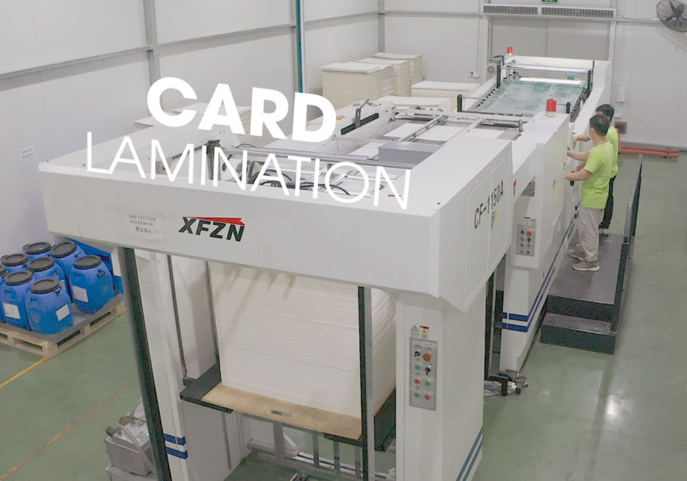
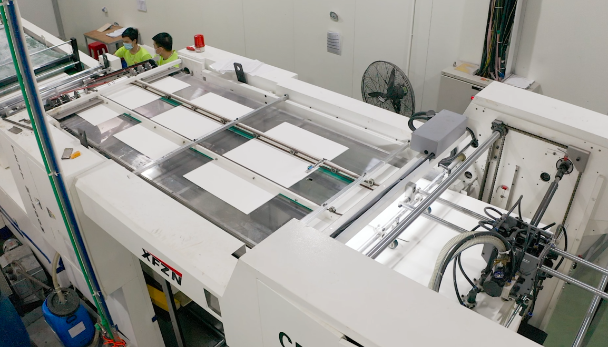
LAMILATION
XING FENG CF1150A
DING XING DX1210
Machine Type | QTY | Brand | MODEL NO.
Card Lamination | 1 | Xing Feng | CF1150A
Machine Type | QTY | Brand | MODEL NO.
Card Lamination | 1 | Ding Xing | DX1210
max size mm | min size mm | capacity(pcs/h)
1200x720 | 450x490 | 4000
max size mm | min size mm | capacity(pcs/h)
1200x1000 | 450x450 | 6000

Slide 10
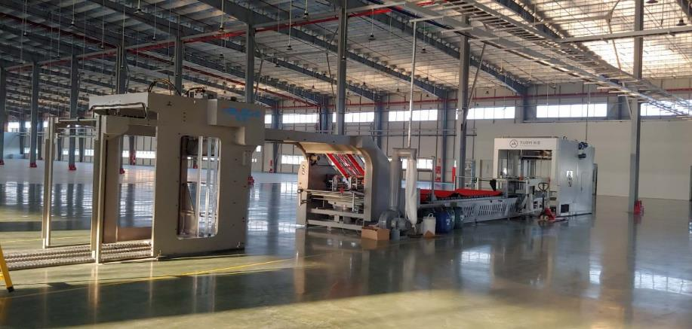
LAMILATION
FENGCHI GW-1450L
Machine Type | QTY | Brand | MODEL NO. | max size mm | min size mm | capacity(pcs/h)
Flute Laminator | 2 | FengChi | GW-1450L | 1450x1450 | 450x350 | 13000

Slide 11
DIE-CUT
7 AUTOMATION DIE CUTTING + 7 SEMI-AUTO DIE CUTTING + 2 HOT STAMPING
Machine Type | QTY | Brand | MODEL NO. | max size mm | min size mm | capacity(pcs/h)
Automation Die Cutting Machine | 1 | Guowang | C130Q | 1285x935 | 550x450 | 4000
Automation Die Cutting Machine | 1 | Guowang | R130Q | 1285x935 | 550x450 | 4000
Automation Die Cutting Machine | 1 | Guowang | C106Q | 1060x760 | 400x350 | 5000
Automation Die Cutting Machine | 1 | Nikko | JY-109 | 1060x750 | 400x360 | 4000
Automation Die Cutting Machine | 1 | MK | Promatrix 145CS | 1450x1060 | 580x450 | 6000
Automation Die Cutting Machine | 2 | MK | Easymatrix 106CS | 1060x750 | 400x360 | 7000
Semi-Auto Die Cutting Machine | 3 | Sansin | ML-1100 | 1100x760 | NA | 1000
Semi-Auto Die Cutting Machine | 1 | Sansin | ML-750 | 750x520 | NA | 1100
Semi-Auto Die Cutting Machine | 3 | Sansin | ML-1500 | 1500x1100 | NA | 800
Semi-Auto Hot Stamping Machine | 2 | Sansin | ML-1100HS | 1100x760 | NA | 1000

Slide 12
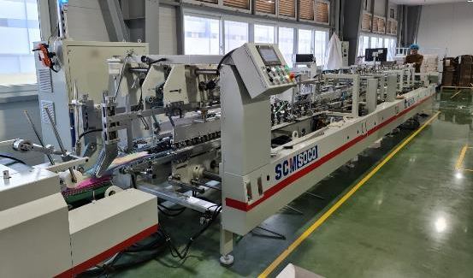
FOLDER - GLUER
SOCO SQ1100DPC-R-E + SOCO SQ750PRC
Machine Type | QTY | Brand | MODEL NO. | max size mm | min size mm | capacity(pcs/h)
Auotmatic Folder Gluer | 1 | Soco | SQ1100DPC-R-E | 1100x800 | 150x85 | 24000m/h
Auotmatic Folder Gluer | 2 | Soco | SQ750PRC | 750x500 | 125x85 | 20000m/h
SHGENGYOU KMD360T 6+6
Machine Type | QTY | Brand | MODEL NO. | max size mm | min size mm | capacity(pcs/h)
Sheet Folder | 1 | Shgengyou | KMD360T 6+6 | 360x750 | 50x100 | 10000m/h

Slide 13
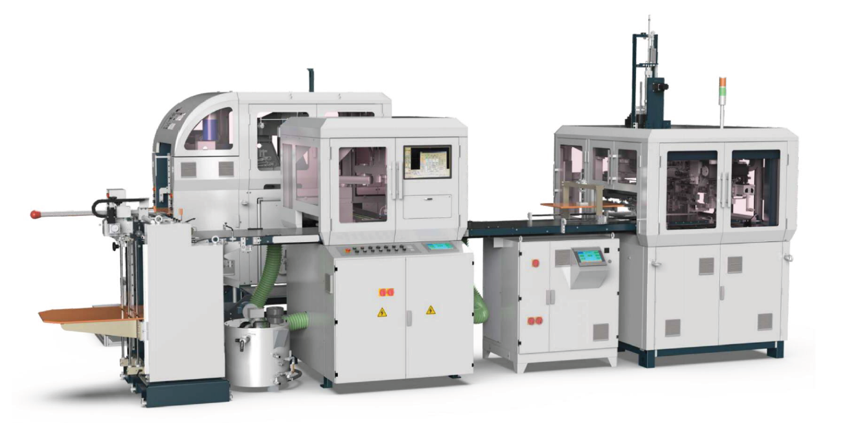
AUTORIGID BOX MACHINE
HM-ZD6418G/HM-ZD6418C-G – 2400 pcs/h
Automatic Rigid Box Machine is suitable to make various big size premium boxes mass production, such as mobile phone boxes, gift boxes, cosmetic boxes, watch boxes, slanting (option), slip case boxes (option), clamshell box (option) etc

Slide 14
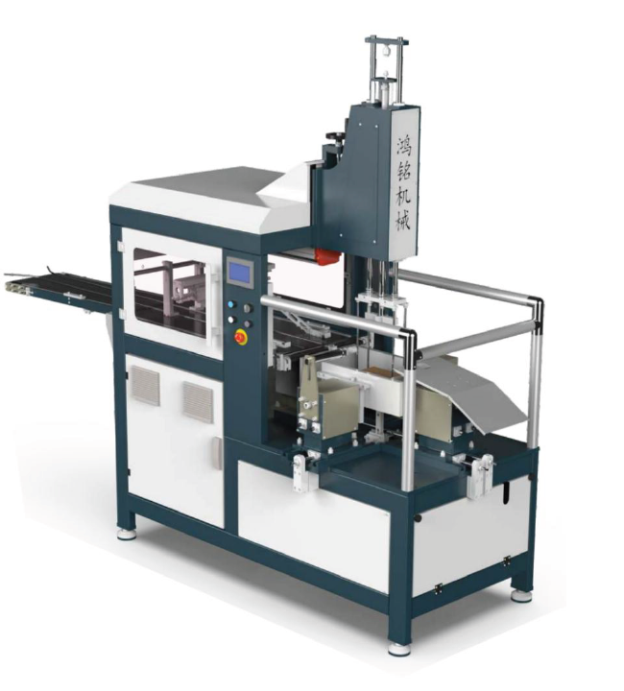
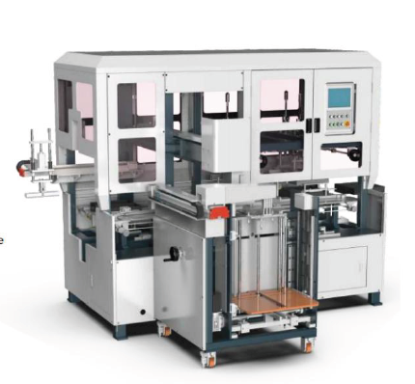
BOX PRESSING CARD PAPER PASTING
H M-YP400/VP600B
Automatic Box Pressing Machine
HM-TK430A Card paper pasting machine

Slide 15
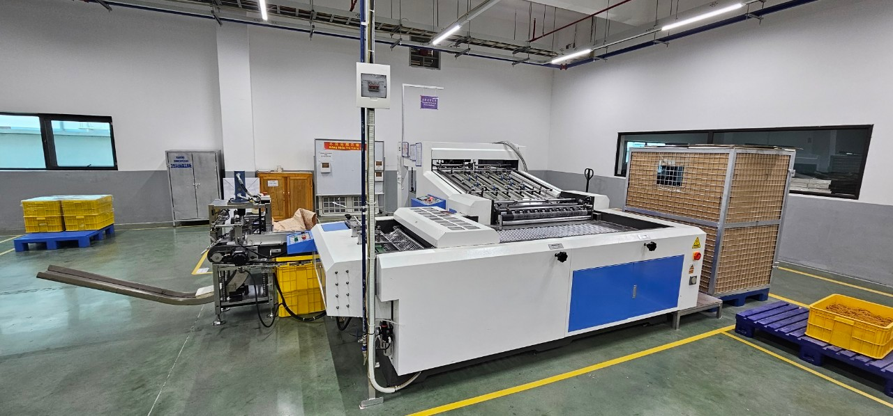
CARD SLITTING AND COLLATING
PK108 - 2800 pcs/h
Fully-automatic card sorting machine is mainly used for all kinds of paper cards, playing cards, educational learning cards, etc for slitting, collating ,die cutting, not only high efficiency, but also high slitting precision.

Slide 16
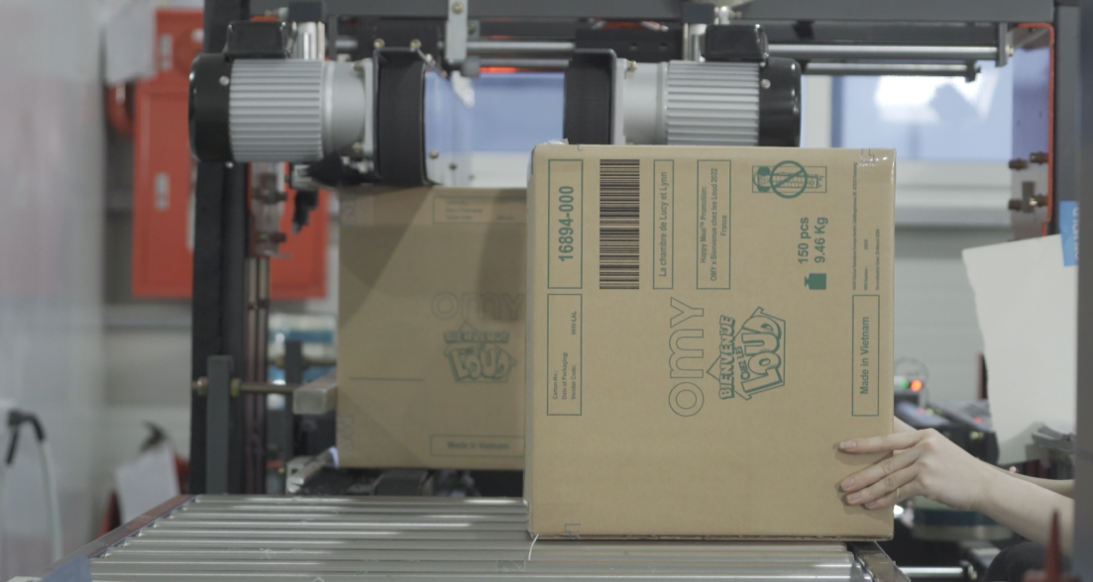
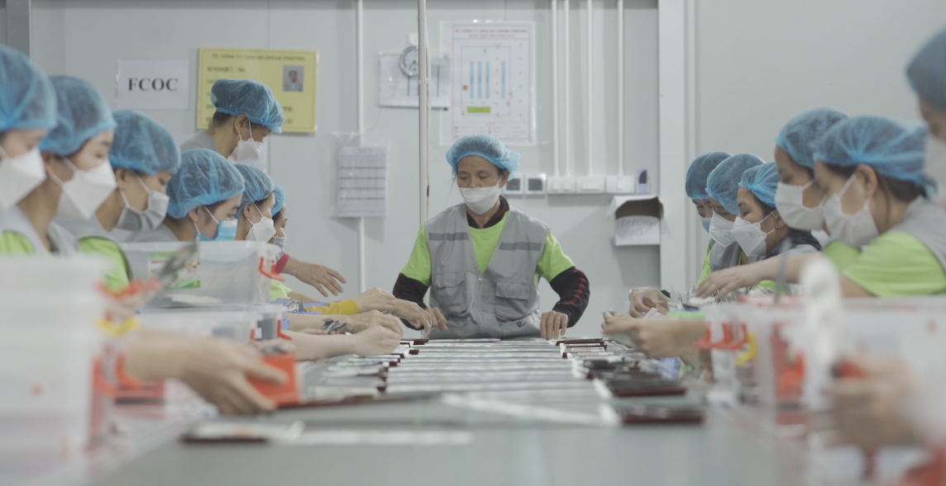
ASSEMBLY LINES
UP TO 12 LINES
1680 m2 x3 floor
Up to 1000 workers
Up to 300k pcs / h
Food Grades
Carefully trained

Slide 17
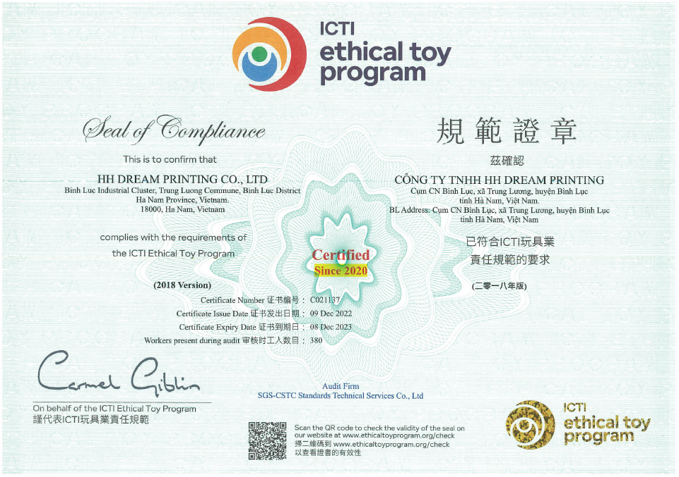
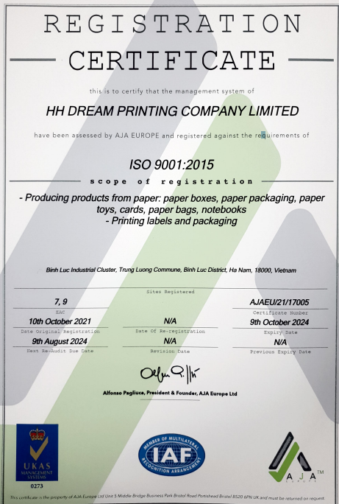
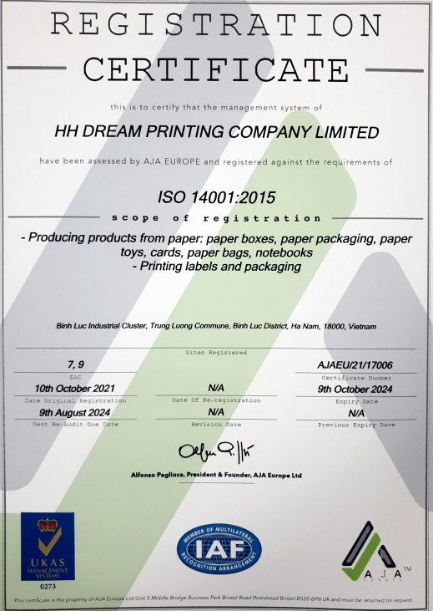
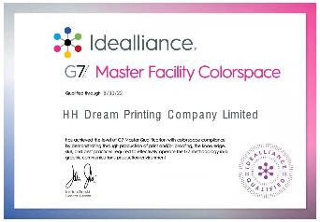
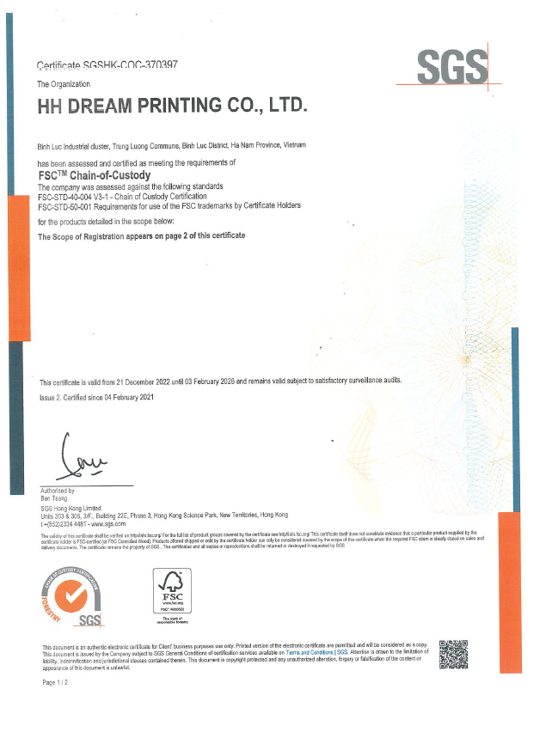
COMPLIANCE & CERTIFICATE
IETP by ICTI
ISO9001
ISO14001
Others – in progress
G7 Master Facility Colorspace
FSC , FAMA, RBA

Slide 18
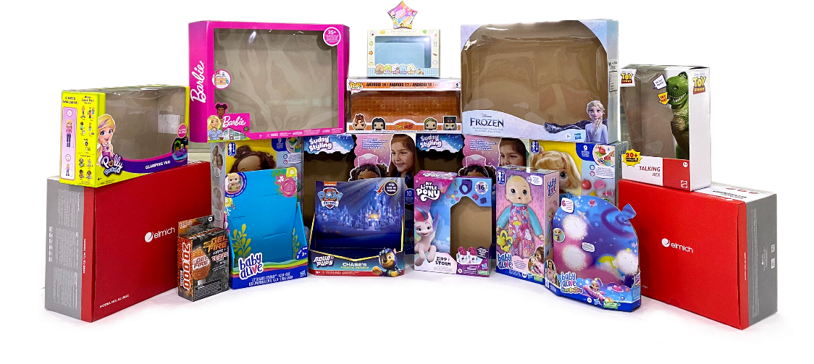
MAIN PRODUCTS
Color Paper Packaging (Color Box, Blister Card)

Slide 19
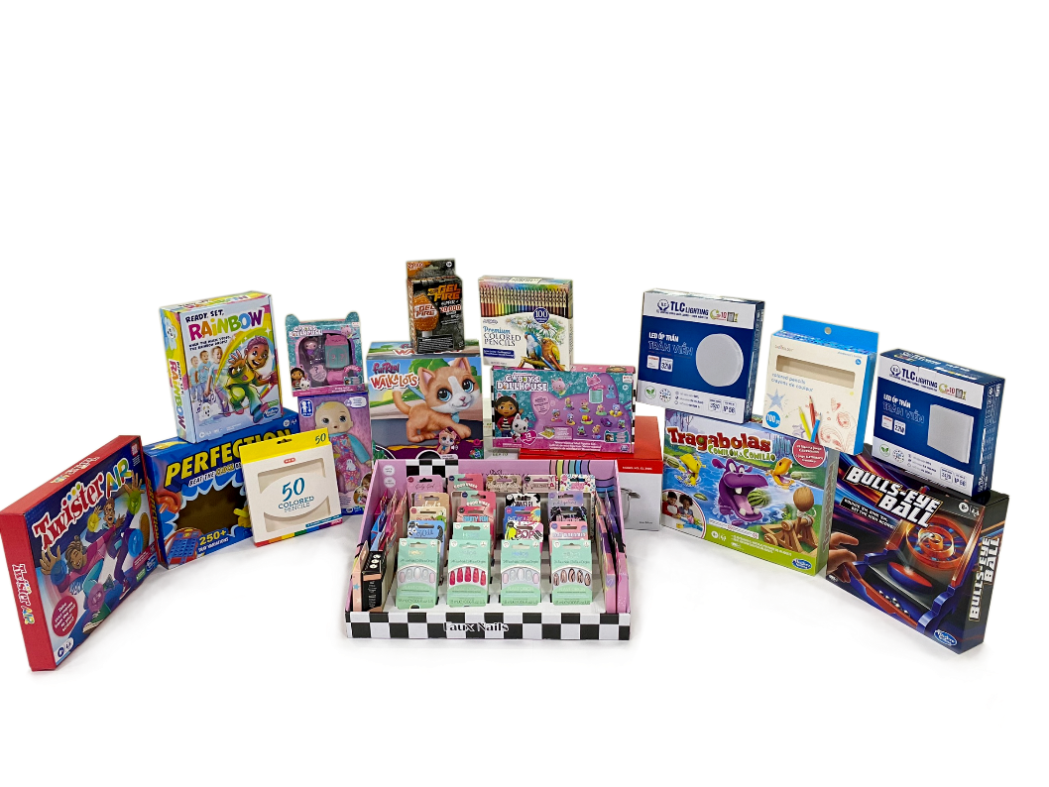
MAIN PRODUCTS
Toy, Stationary, Electronic products

Slide 20
MAIN PRODUCTS
Paper Toy Game board, Figure, Puzzle …

Slide 21
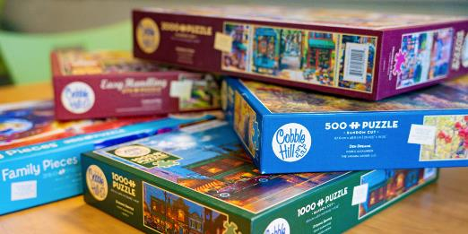
WE ARE LOOKING FOR:
PUZZLES, BOARD GAMES
We are looking for more
Products such as Puzzles,
Paper board games, games
sets
BOOKS
Children's books, color books
and other publications.
Publication printing permit
will be ready in 2024

Slide 22
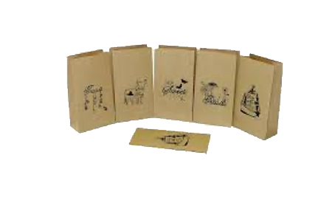
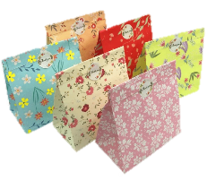
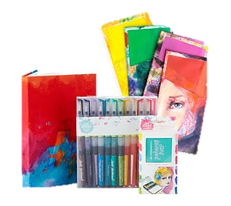
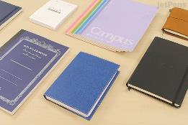
ITEMS THAT CAN BE PRODUCED
Deluxe
Packaging
Paper Bags
Various
Paper
Product
Greeting
Cards
Stationery

Slide 23
EXTENED FACTORY
WORKSHOP
1680 m2 x3 floor
More than 300 workers
WAREHOUSE
1680 m2
More than 2000 pallets

Slide 24
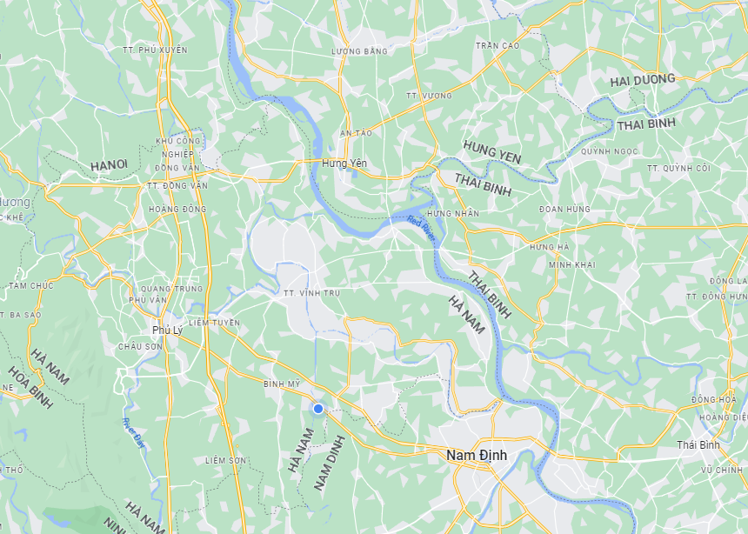
WHAT’S NEXT?
HH DREAM
THAI HA
HH DREAM
BINH LUC

Slide 25
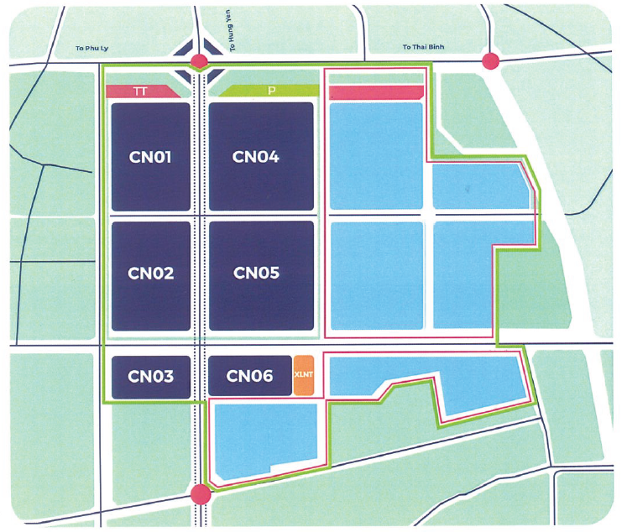
WHAT’S NEXT?
HH Dream Thai Ha
50000m2
Will be started on 2025

Slide 26
WHAT’S NEXT?
NEAR FUTURE
Publication printing licence.
At least 6 total printing machines
More automatic die-cut machines
GET OUR OWN APPROVED LAB
To be completed in 2023
PHASE 3
New Production Facilities
HH Thai Ha

Slide 27
THANK YOU

